Slide 1

Name: Ouch Reaksmey
Major: Business and Enterprise Management
Email: meymeyouch@yahoo.com
ouchreaksmey10@mekong.edu.kh
Academic Year: 2010-2011

Slide 2
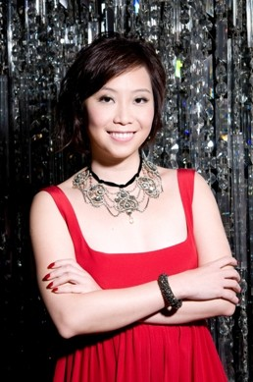
Young Entrepreneur in Asia
Background
Name: Yenn Wong
Age: 31
Nationality: Singaporean
Country: Singapore
Company: JIA Group
Education: University of Western
Australia
Website: www.yennwong.com

Slide 3

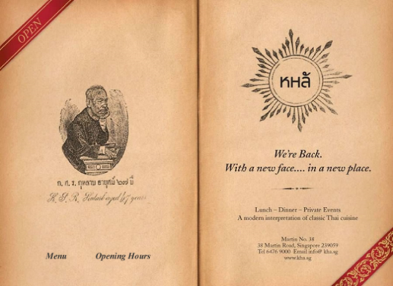
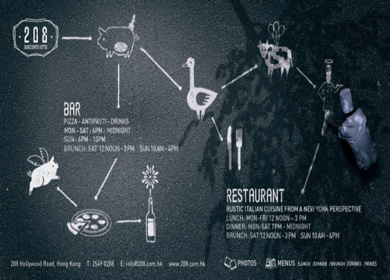
Yenn’s Company
She runs two JIA boutique hotels, one is JIA Hong Kong and the other one is JIA Shanghai with her partner, Philippe Starck .
Graze, Kha, 208 Duecento Otto, and Issimo are part of JIA Group.
Kha restaurant
208 restaurant

Slide 4
Yenn’s Successful Story
JIA Boutique Hotel was first invested for $1,200 millions.
She has created for a new JIA in shanghai, as well as six restaurants.
Her hotels has been recognized by over millions people all over the world.
Wong and her achievements has won several awards since she found JIA Group.

Slide 5
Yenn’s Idea
“I had financial support, but you cannot create
something from nothing with just money. There
is foresight, commitment, passion, and hard
work.”
References: http://www.jiaboutiquehotels.com/
http://www.jiahongkong.com/JIA.html\

Slide 6
Thanks for paying
Attention!

Slide 7
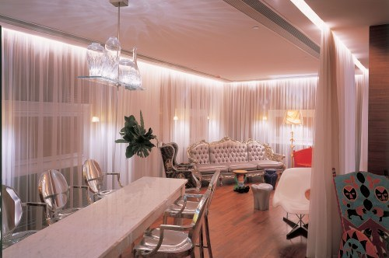
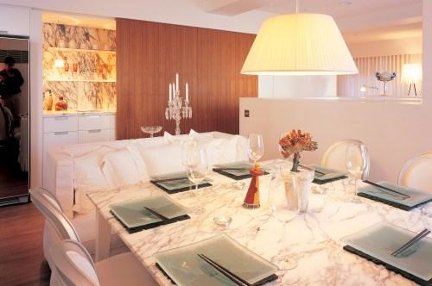
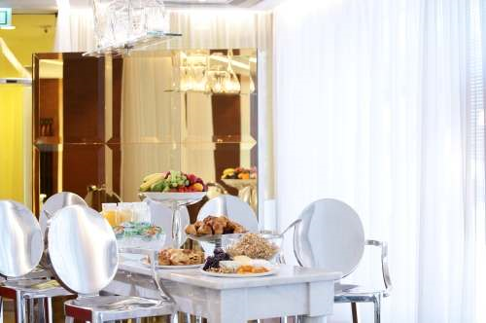
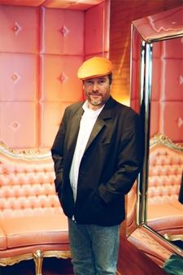
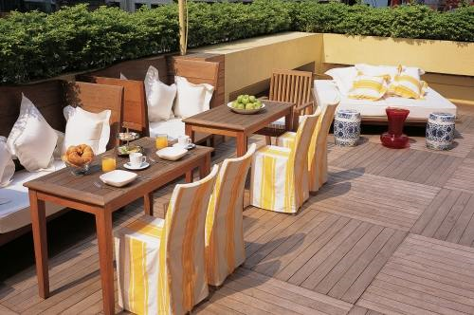
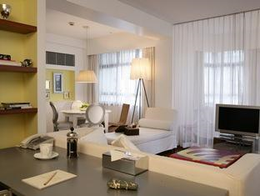
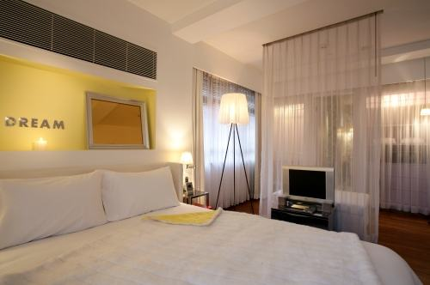
Philippe Starck

